Slide 1
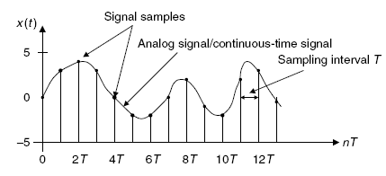
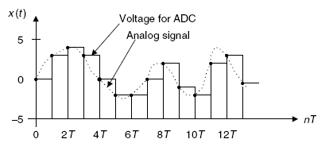
Signal Processing
Lec. 3
Signal Sampling and Reconstruction
3.1 Sampling of Continuous Signal
Figure 3.1 shows an analog (continuous-time) signal (solid line) defined at every point over the time axis
and amplitude axis. Hence, the analog signal contains an infinite number of points.
Figure 3.1 Display of the analog (continuous) signal and display of digital samples versus the sampling time instants
It is impossible to digitize an infinite number of points. Furthermore, the infinite points are not appropriate to be processed by the digital signal (DS) processor or computer, since they require an infinite amount of memory and infinite amount of processing power for computations. Sampling can solve such a problem by taking samples at the fixed time interval, as shown in Figure 3.1 and Figure 3.2, where the time T represents the sampling interval or sampling period in seconds.
Figure 3.2 Sample-and-hold analog voltage for ADC

Slide 2
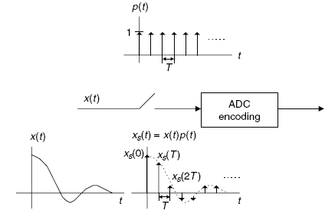
Signal Processing Lec. 3
As shown in Figure 3.2, each sample maintains its voltage level during the sampling interval T to give the ADC enough time to convert it. This process is called sample and hold. For a given sampling interval T, which is defined as the time span between two sample points, the sampling rate is therefore given by:
After the analog signal is sampled, we obtain the sampled signal whose amplitude values are taken at the sampling instants, thus the processor is able to handle the sample points. Next, we have to ensure that samples are collected at a rate high enough that the original analog signal can be reconstructed or recovered later.
In other words, we are looking for a minimum sampling rate to acquire a complete reconstruction of the analog signal from its sampled version.
If an analog signal is not appropriately sampled, aliasing will occur, which causes unwanted signals in the desired frequency band. The sampling theorem guarantees that an analog signal can be in theory perfectly recovered as long as the sampling rate is at least twice as large as the highest-frequency component of the analog signal to be sampled. The condition is described as:
f ≥ 2 f
s max
Where, f is the maximum-frequency component of the analog signal to be sampled
max
For example, to sample a speech signal containing frequencies up to 4 kHz, the minimum sampling rate is chosen to be at least 8 kHz, or 8,000 samples per second; to sample an audio signal possessing frequencies up to 20 kHz, at least 40,000 samples per second, or 40 kHz, of the audio signal are required. Figure 3.3
depicts the sampled signal x (t) obtained by sampling the continuous signal x(t) at a sampling rate of f samples
s s
per second.
Figure 3.3 The simplified sampling process

Slide 3
Signal Processing Lec. 3
Mathematically, this process can be written as the product of the continuous signal and the sampling pulses (pulse train):
x (t) = x(t) p(t)
(3.3)
s
Where, p(t) is the pulse train with a period T = 1/ f
s
From the spectral analysis shown in Fig. 3.4, it is clear that the sampled signal spectrum consists of the
scaled baseband spectrum centered at the origin and its replicas centered at the frequencies of nf± (multiples
s
of the sampling rate) for each of n = 1,2,3, . . . .In Figure 2.4, three possible sketches are classified. Given the original signal spectrum X(f) plotted in Figure 3.4(a), the sampled signal spectrum is plotted in Figure 3.4(b),
where, the replicas have separations between them. In Fig. 3.4(c), the baseband spectrum and its replicas are just connected. In Fig. 3.4(d), the original spectrum and its replicas are overlapped; that is, there are many
overlapping portions in the sampled signal spectrum. If applying a lowpass reconstruction filter to obtain
exact reconstruction of the original signal spectrum, equation (3.2) must be satisfied. This fundamental conclusion is well known as the Shannon sampling theorem, which is formally described below:
For a uniformly sampled DSP system, an analog signal can be perfectly recovered as long as the sampling rate is at least twice as large as the highest-frequency component of the analog signal to be sampled.
We summarize two key points here
1. Sampling theorem establishes a minimum sampling rate for a given band limited analog signal
with the highest-frequency component f . If the sampling rate satisfies equation (3.2), then the
max
analog signal can be recovered via its sampled values using the lowpass filter, as described in Fig. 3.4(b).
2. Half of the sampling frequency (f / 2) is usually called the Nyquist frequency (Nyquist limit), or
s
folding frequency. The sampling theorem indicates that a DSP system with a sampling rate of f
s
can ideally sample an analog signal with its highest frequency up to half of the sampling rate without introducing spectral overlap (aliasing). Hence, the analog signal can be perfectly recovered from its sampled version as described in Fig. 3.4 (c). Fig. 3.4(d) shows aliasing.

Slide 4
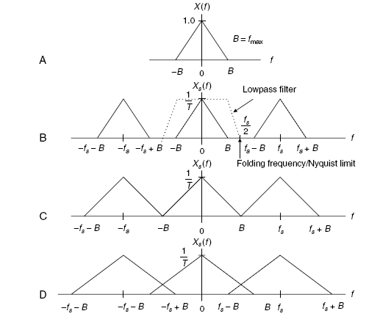
Signal Processing
Lec. 3
Fig. 3.4 plots of the sampled signal spectrum.
Example(1)
Suppose that an analog signal is given as of 8,000 Hz.
Sketch the spectrum for the original signal.
Sketch the spectrum for the sampled signal from 0 to 20 kHz.
Solution:
and is sampled at the rate
The two-sided spectrum is plotted as shown in Fig. 3.5 (a). After the analog signal is sampled at the rate of
8,000 Hz, the sampled signal spectrum and its replicas centered at the frequencies ±nf , each with the scaled
s
amplitude being 2.5/T, are as shown in Fig. 3.5(b)
The two-sided spectrum is plotted as shown in Fig. 3.5 (a). After the analog signal is sampled at the rate of
8,000 Hz, the sampled signal spectrum and its replicas centered at the frequencies ±nf , each with the scaled
amplitude being 2.5/T, are as shown in Fig. 3.5(b)
s

Slide 5
Signal Processing
Lec. 3
Fig. 3.5 (a) Fig. 3.5(b)
Notice that the spectrum of the sampled signal shown in Figure 2.5(b) contains the images of the original
spectrum shown in Figure 3.5(a); that the images repeat at multiples of the sampling frequency f (for our
s example, 8 kHz, 16 kHz, 24 kHz, . . . ); and that all images must be removed, since they convey no additional information.
3.2 Signal Reconstruction
Two simplified steps are involved, as described in Figure 3.6. First, the digitally processed data y(n)
are converted to the ideal impulse train y (t), in which each impulse has its amplitude proportional to digital
s
output y(n), and two consecutive impulses are separated by a sampling period of T; second, the analog
reconstruction filter is applied to the ideally recovered sampled signal y (t) to obtain the recovered analog
s
signal.
The following three cases are listed for recovery of the original signal spectrum:
In this case, Nyquist frequency is equal to the maximum frequency of the analog signal x(t), an ideal lowpass reconstruction filter is required to recover the analog signal spectrum. This is an impractical case.
In this case, there is a separation between the highest-frequency edge of the baseband spectrum and the lower edge of the first replica. Therefore, a practical lowpass reconstruction (anti-image) filter can be designed to reject all the images and achieve the original signal spectrum.
This is aliasing, where the recovered baseband spectrum suffers spectral distortion, that is, contains an aliasing noise spectrum; in time domain, the recovered analog signal may consist of the aliasing noise frequency or frequencies. Hence, the recovered analog signal is incurably distorted.

Slide 6
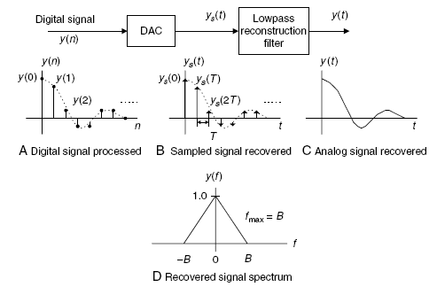
Signal Processing
Lec. 3
Fig. 3.6 Signal notations at reconstruction stage

